Slide 1
What’s the Problem?
The need to create a model to project the future of investments in Big Mountain resorts, specifically focusing on four scenarios
Scenario 1: Permanently closing 10 least used runs

Slide 2
What’s the Problem?(contin)
Scenario 2: Increasing vertical drop by adding another point, 150 ft lower, no additional snow cover
Scenario 3: Similar as Scenario 2, but with an addition of 2 acres of snow making
Scenario 4: Increase the longest run by 0.2 miles to have the longest run(3.5 miles) with 4 acres of snow making

Slide 3
Recommendations and Key Findings
There are some key features that have a direct correlation to ticket pricing(rank from most to least important): vertical drop, Snow Making_ac, total_chairs, fastQuads, Runs, LongestRun_mi, trams, and SkiableTerrain_ac
We also discovered the Montana resort is undercharging which will be later explained when discussing about the modeling results section of the Powerpoint
Scenarios 1-3 should be implemented at a slow rate to ensure that current ticket prices somewhat matches projected ticket prices.

Slide 4
Modeling Results and Analysis
The model that was selected and created is based on a random forest model with a 70/30 training/testing split(checking the reliability of the model)
Model discovered that the resort of interest, Montana, is charging $81.00 , but model projects $100.24.
The model also analyze the four different scenarios, projecting any kind of ticket price increase.

Slide 5
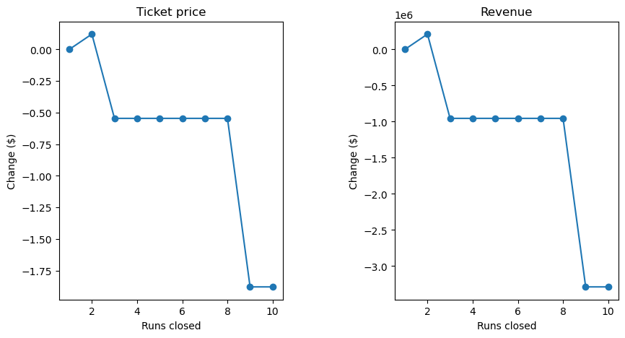
Modeling Results and Analysis
Scenario 1: The outcome projected that the closure of one to two runs will drop ticket price/revenue. Although ,after closing 3-8 runs the ticket price remains the same as seen on these graphs:

Slide 6
Modeling Results and Analysis
Scenario 2: Increased ticket price by $8.48 is expected creating a revenue of $14,848,485. To be expected considering this would increase amount of vertical drop and runs.
Scenario 3: It is not surprising that this scenario also increases revenue. However, the increase of ticket price with the additional snow making would be $9.36.
Scenario 4: Unlike the other scenarios the increase length of run does not predict an increase in ticket price. This mainly because longest run is not the most important feature in a ski resort

Slide 7
Summary and Conclusion
In conclusion Scenarios 1-3 should be further investigated to increase revenue while Scenario 4 can be ignored.
Data analyzed can be further improved if other data is provided such as number of guest
Furthermore, implementing Scenarios 1-3 at a slow rate to allow the company flexibility and change of course if real time data unmatch does not match the projected numbers.

